Slide 1
OneExpert DSP ONX-220 Release
Ookla Speed Test and OneCheck Fiber

Slide 2
Ookla Speed Test

Slide 3
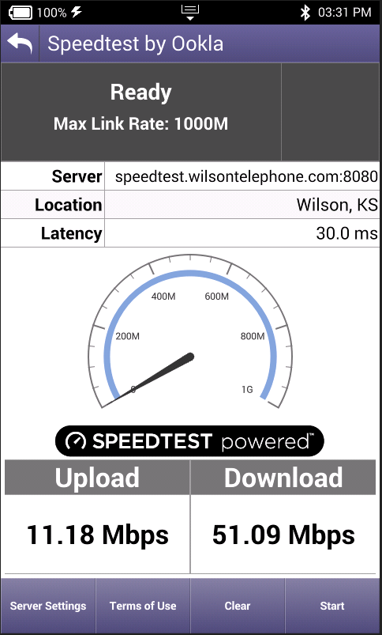
Ookla Speed Test
Customers are already familiar with Ookla
Limitations Apply
Simple 1-button start – no knowledge of service rates required
Utilizes existing Ookla server infrastructure service – no new server expenditure required
Consumer focused operation and results
Automatically selects best server based on latency and loading
Downstream & Upstream rates up to 1Gbps
Can use a specific server by IP address/URL
Ethernet only in this release. DOCSIS and WiFi in later release.

Slide 4
OneCheck Fiber

Slide 5
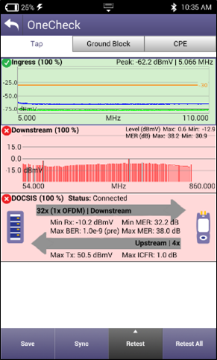
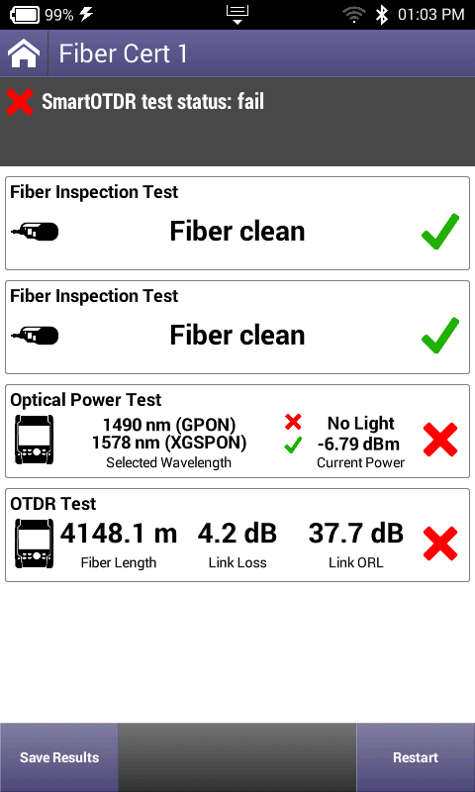
OneCheck Tests
One-button test
Easily customized to match your Methods & Procedures
Reducing install time
Ensuring installation quality
Reducing repeats
One Button, Many Tests
OneCheck CATV
OneCheck Fiber

Slide 6
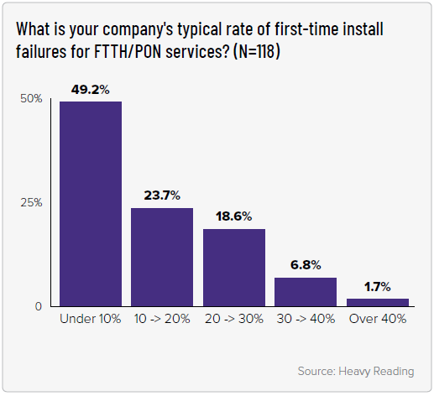
Why do fiber tests?
First-time install failures >10% for majority of service providers
When that happens, a tech needs to go back to fix ($)
Tech is diverted from other productive work ($)
Customer is inconvenienced, and liable to churn ($$)

Slide 7
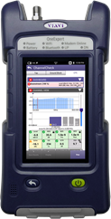
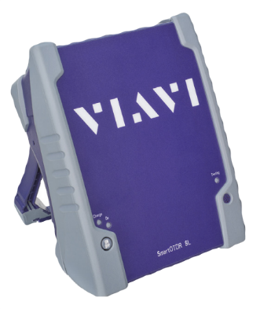
Consolidated Workforce – Testing FTTH
Fiber test accessories / add-ons to ONX – techs are familiar with ONX and already integrated into workflow system
P5000i fiber inspection scope – ensure clean, reliable connections
SmartOTDR SL – one connection to test for both power and OTDR
PON power meter
GPON and XGSPON more prevalent
Using a BB-PM does not provide tech validation they are getting the correct light
Inservice fault finder (1650nm OTDR)
No need to disconnect fiber from OLT, which these techs typically do not have access to or not responsible for
Service layer testing, such as Ookla speed test up to 1Gbps

Slide 8
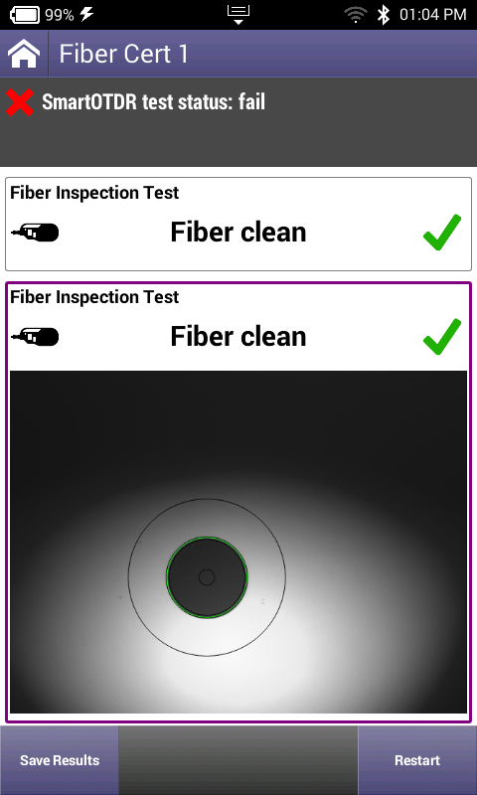
OneCheck Fiber – Simple Test Consolidation
One button, many tools:
One button to start the test
Repeatable test
Data is all tied together
Results tied to workorder for easy job submittal and reporting in StrataSync
Helps technicians and contractors get job done correctly the first time
Notes:
Replace ad-hoc fiber tests (often “plug & pray”) with repeatable testing:
Inspection for both fiber cable and bulkhead connectors
PON power meter to verify the right light (G-PON or XGS-PON) and adequate power to ONT
Fiber fault finder to qualify the fiber and all connectors with Pass/Fail
With one button press and objective Pass/Fail analysis, eliminate guesswork of fiber certification
Know when a helper ticket is required, reducing Invalid Helper Tickets and unnecessary equipment swaps & drop replacements.
Enable techs to get it right the ﬁrst time; drive behavior for ﬁber handling best practices
Ensure the network is working up to the home demarcation point

Slide 9
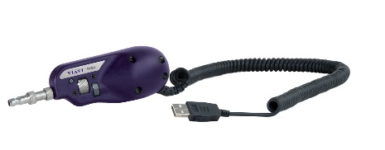
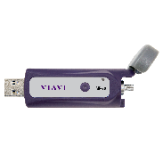
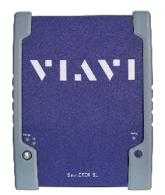
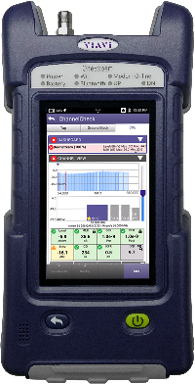
Included tests, instruments, accessories
Fiber scoping ensures clean, reliable connections
Optical power level measurements to ensure that the network is working according to design up to the home demarcation point
OTDR tests characterize and certify the fiber as provided to the subscriber, or locate faults

Slide 10
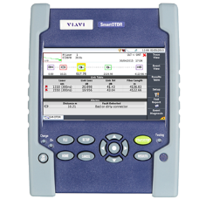
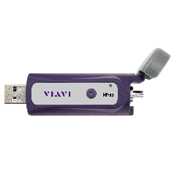
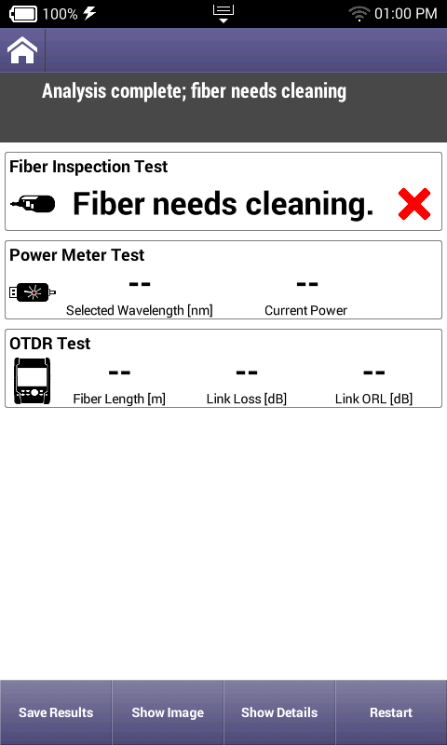
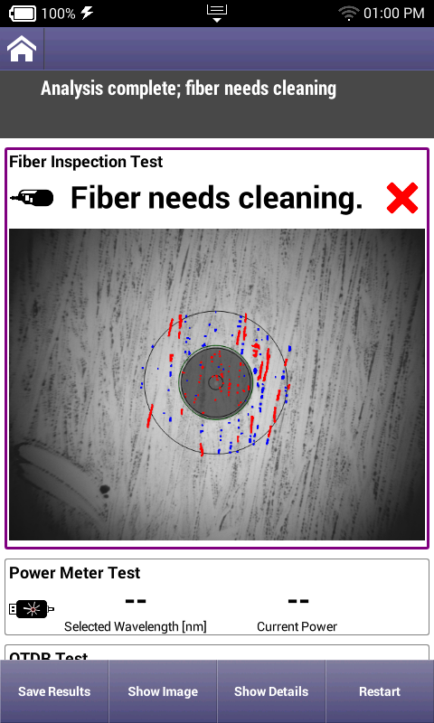
OneCheck Fiber
Step by Step process for mistake proof fiber installations
Results tied to workorder for easy job submittal and reporting in StrataSync
Helps contractors get job done correctly the first time
Clear indicator of pass/fail status of each step
Automated inspection eliminates mistakes
Incorporate SmartOTDR SL with simple diagram – no need to interpret traces
Notes:
Displays OTDR results in a simple, icon-based map view (SmartLink), for a clear diagnostic of detected issues.
Having OTDR capability works well with the workflow management, keeping results for workorder together.

Slide 11
Debbi Kosakowski - National Sales Manager
dkosakowski@specialized.net • 727-515-0911
Eleanor Barszowski - NE Regional Sales Manager
ebarszowski@specialized.net • 484-955-3178
Carolyn Thompson
carolyn@specialized.net • 800-794-1500

